Slide 1
Clean Code Motivation for Developers
By
Damodar Lohani
Lohani Tech

Slide 2
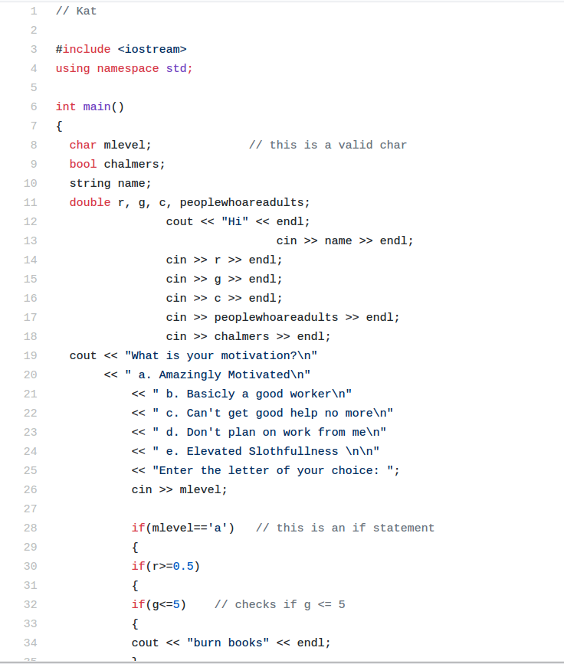
Example

Slide 3
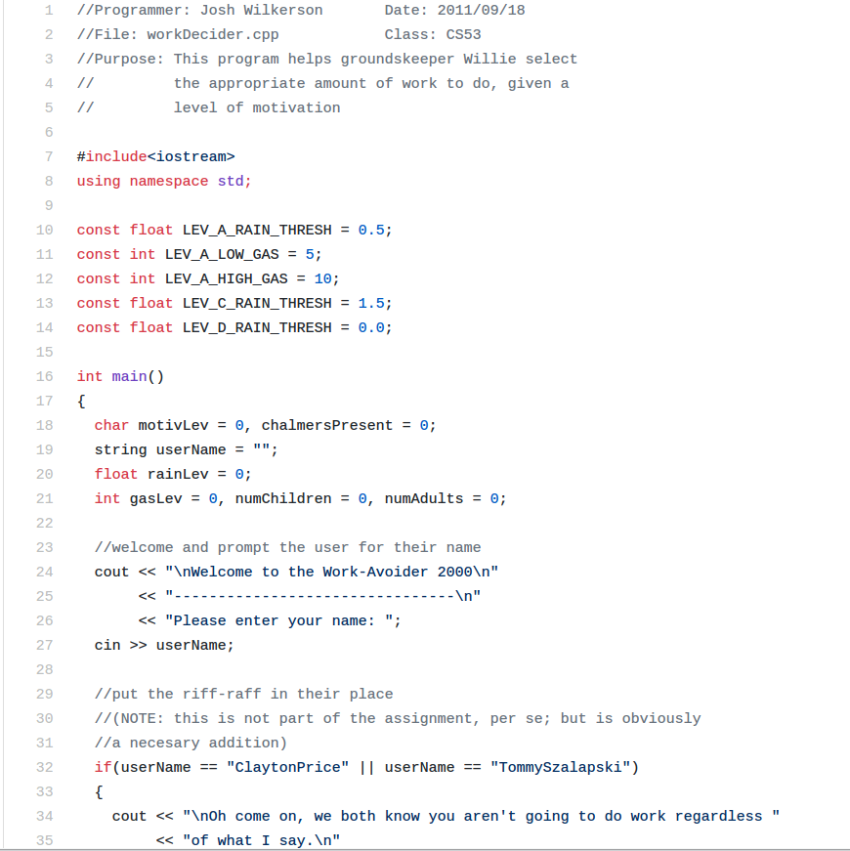
Example

Slide 4
What is Clean Code?
Any fool can write code that a computer can understand. Good programmers write code that humans can understand - Martin Fowler

Slide 5
Why write clean code?
We read code more often than we write

Slide 6
How to write clean Code?
Learn to detect the smell of bad code
Write really obvious code
Refactor often
Strong cohesion
Automate
Gotta care
check and recheck your code

Slide 7
How...?
Write code that writes code
Design to test
Document everything

